Slide 1
Dissertation Stage-II (PHN-600B) End-Term Presentation Supervisor – Dr H S Nataraj
Laksh Arora
20615013

Slide 2
Topic Solving the Dirac Hamiltonian for Many Electron Atoms using Dirac Hartree Fock Self Consistent Field Method in MATLAB

Slide 3
Dirac Hartree Fock Theory
A summary of Szabo and Ostlund (1996) and Nataraj (2021b).

Slide 4
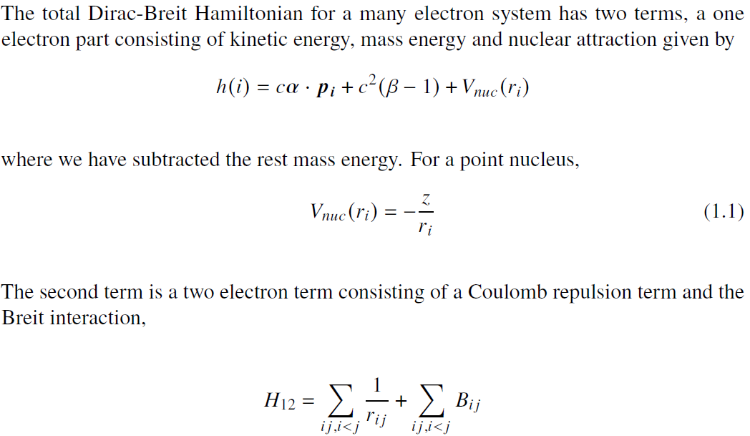
Dirac Hamiltonian

Slide 5
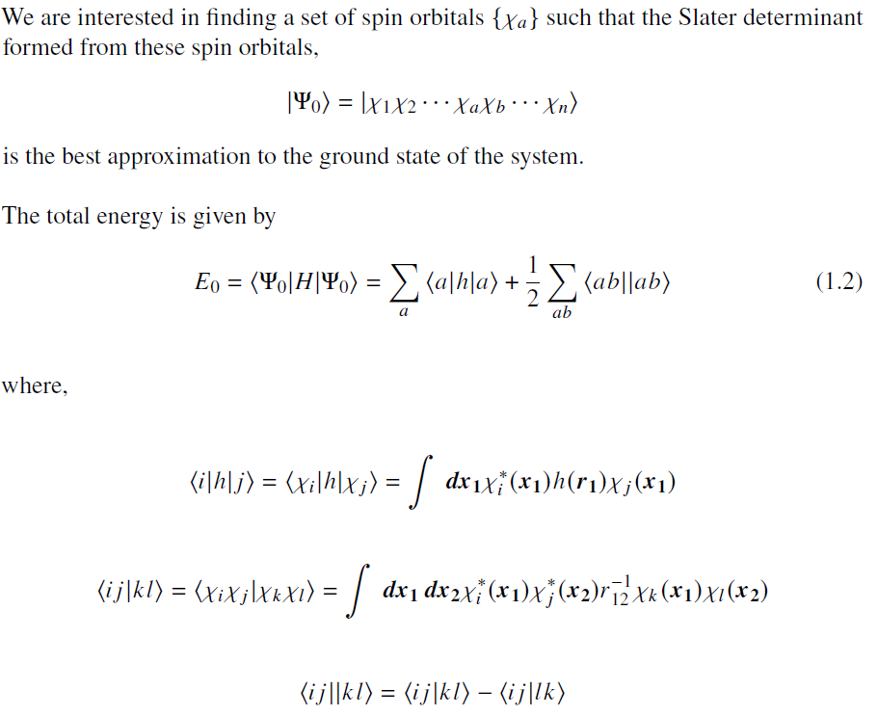
Hartree-Fock Equations

Slide 6
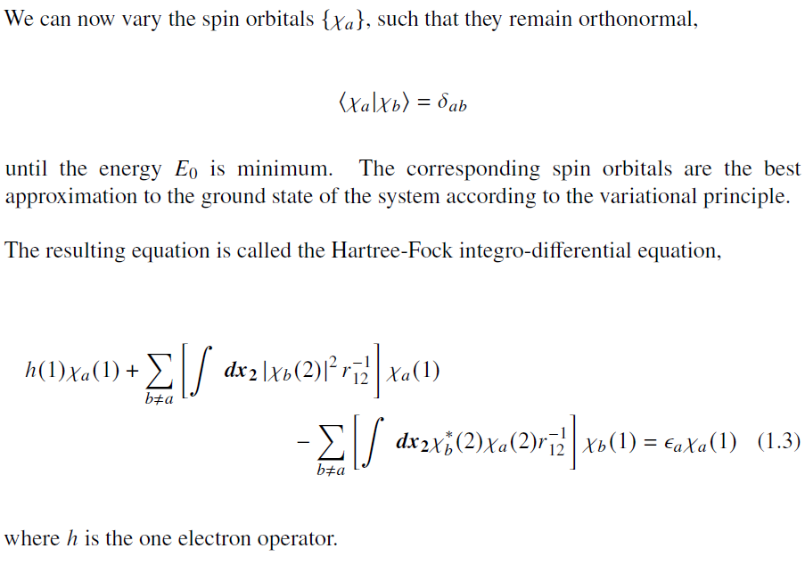
Hartree-Fock Equations

Slide 7
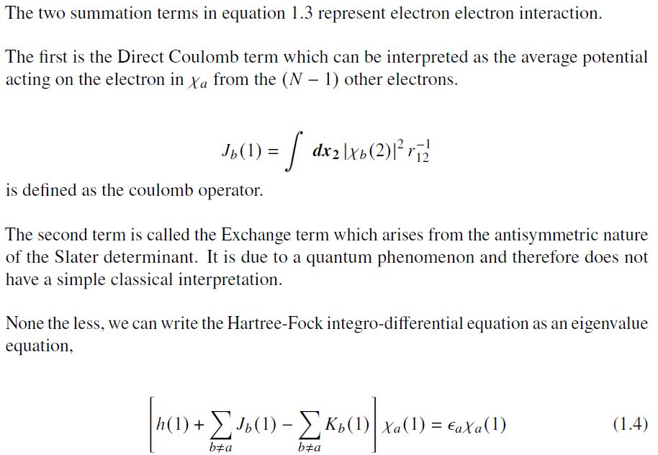
Hartree-Fock Equations

Slide 8
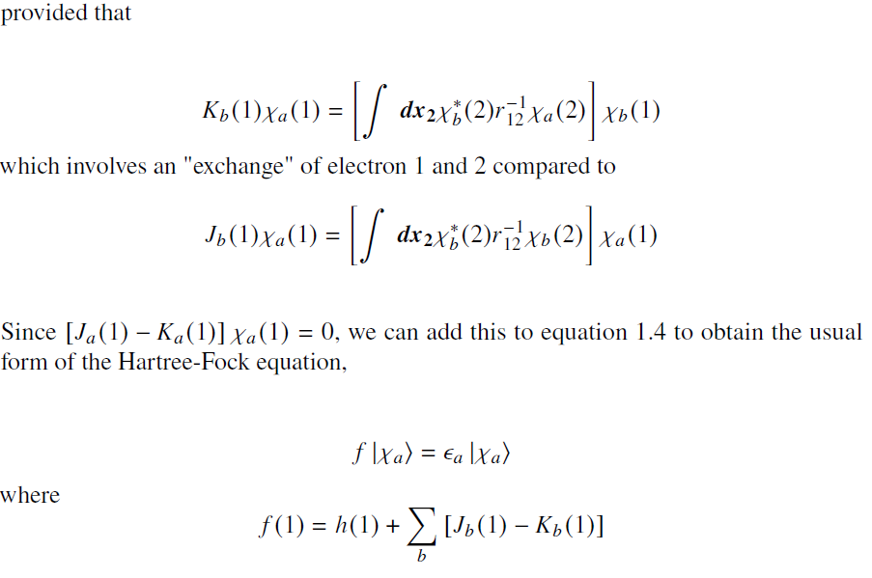
Hartree-Fock Equations

Slide 9
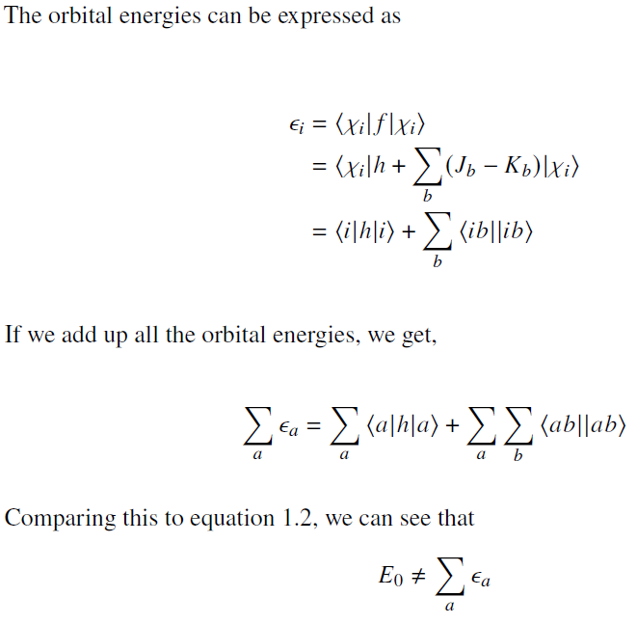
Interpretation of Solutions

Slide 10
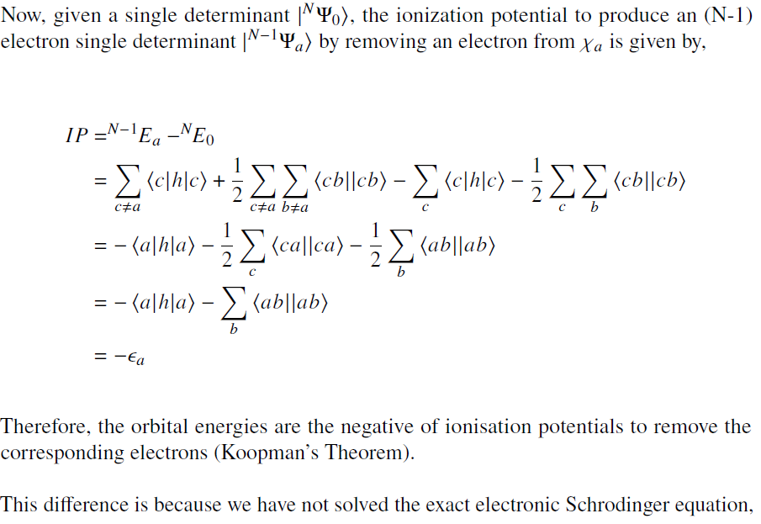
Interpretation of Solutions

Slide 11
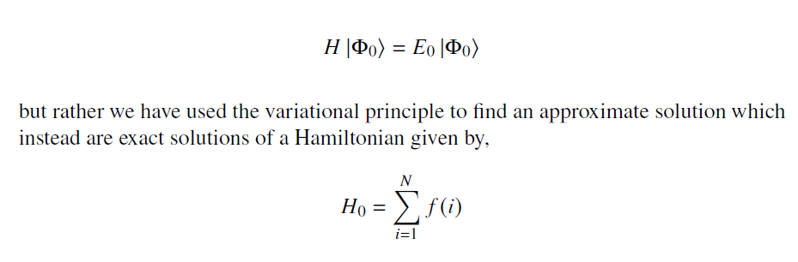
Interpretation of Solutions

Slide 12
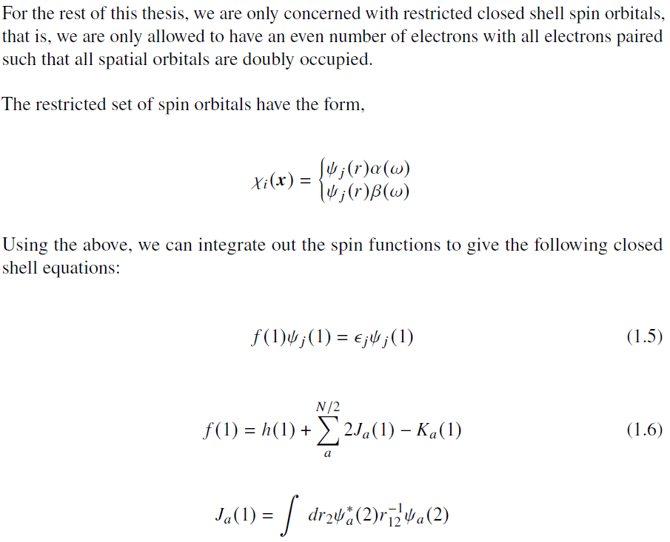
Restricted Closed shell Hartree-Fock
We

Slide 13
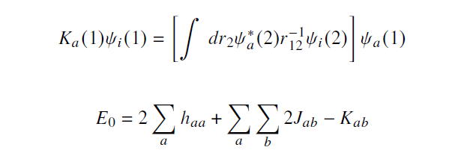
Restricted Closed shell Hartree-Fock

Slide 14
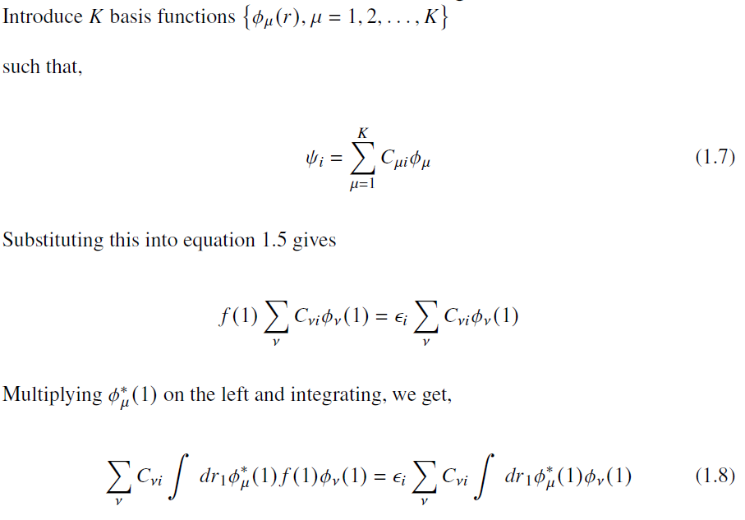
Basis: Roothan Equations

Slide 15
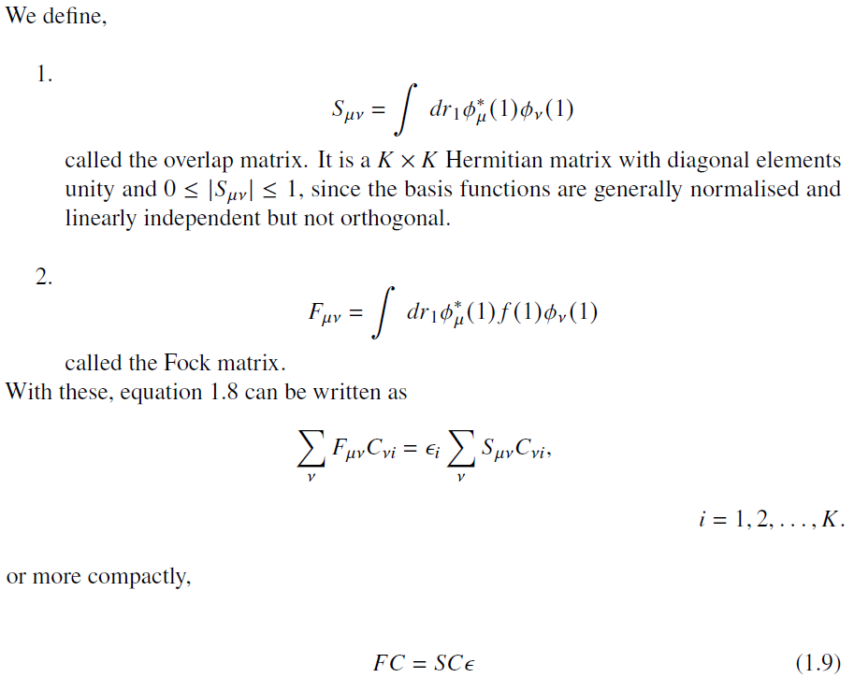
Basis: Roothan Equations

Slide 16
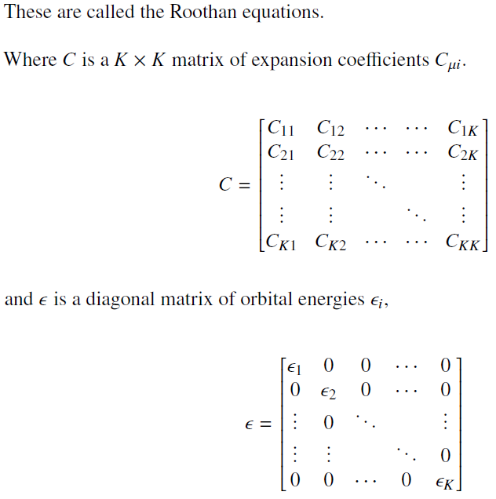
Basis: Roothan Equations

Slide 17
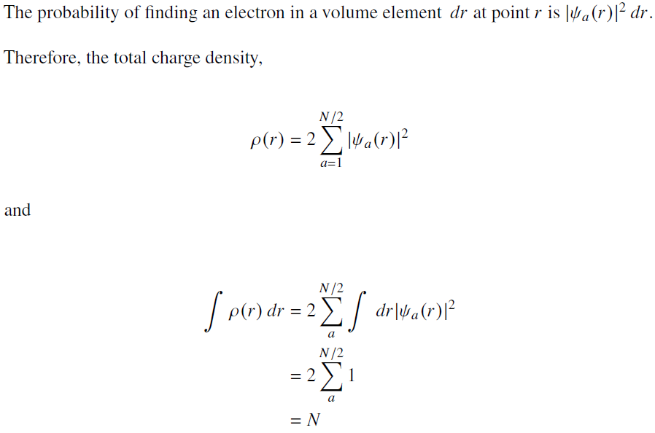
Charge Density

Slide 18
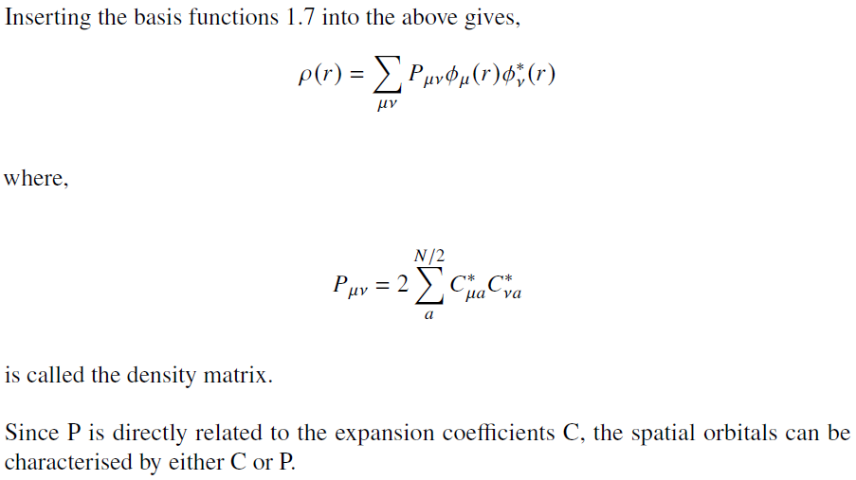
Charge Density

Slide 19
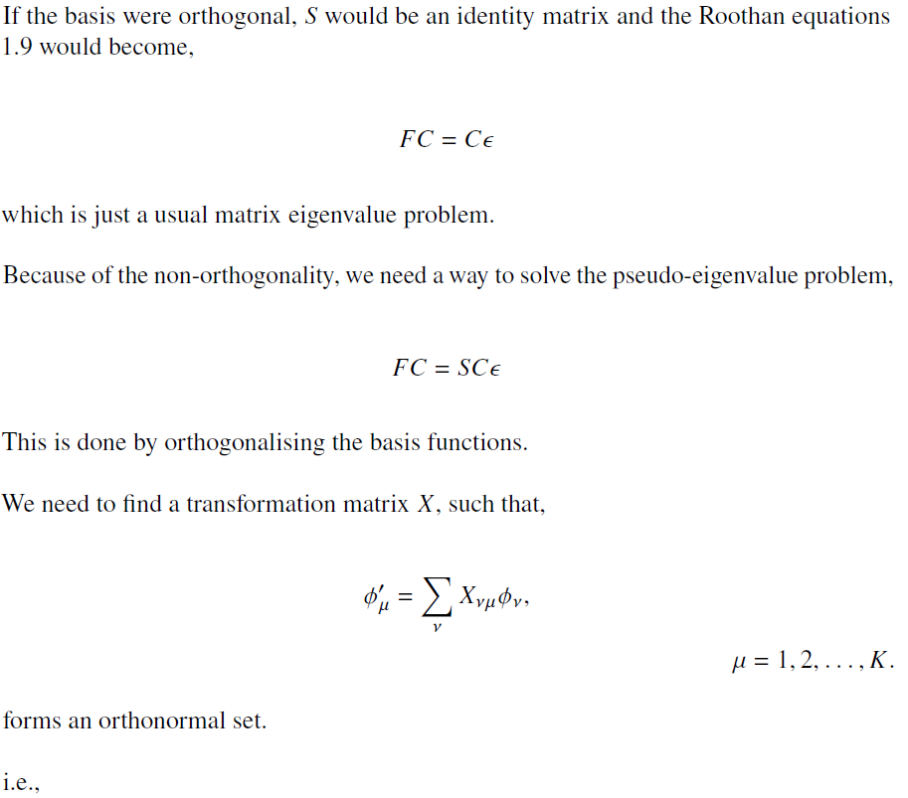
Orthogonalisation of basis: Solving the Roothan Eqs.

Slide 20
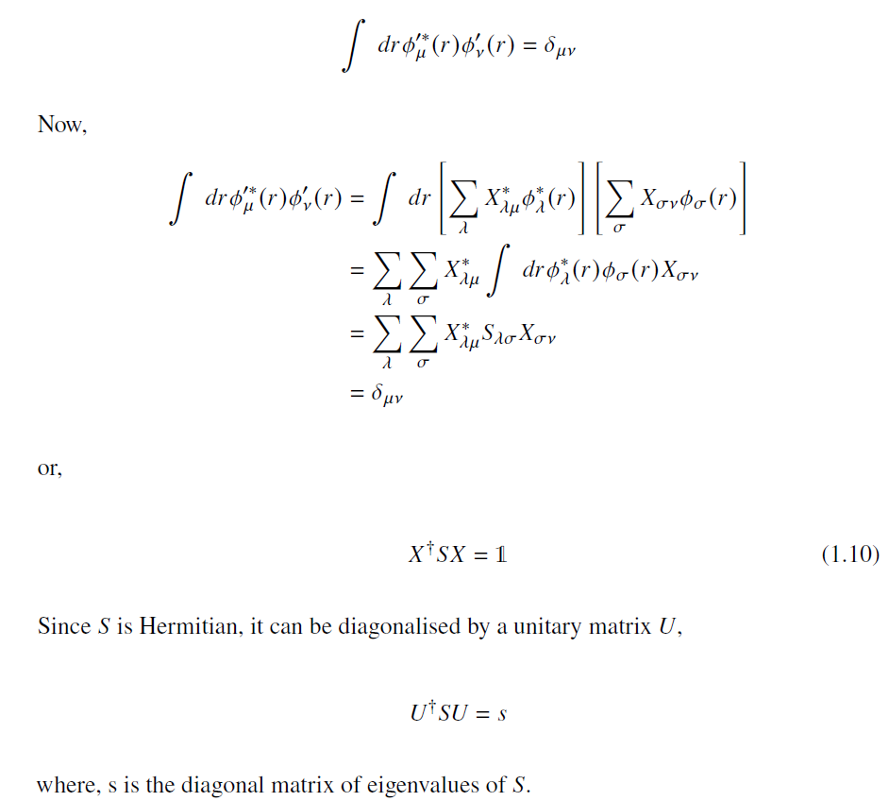
Orthogonalisation of basis: Solving the Roothan Eqs.

Slide 21
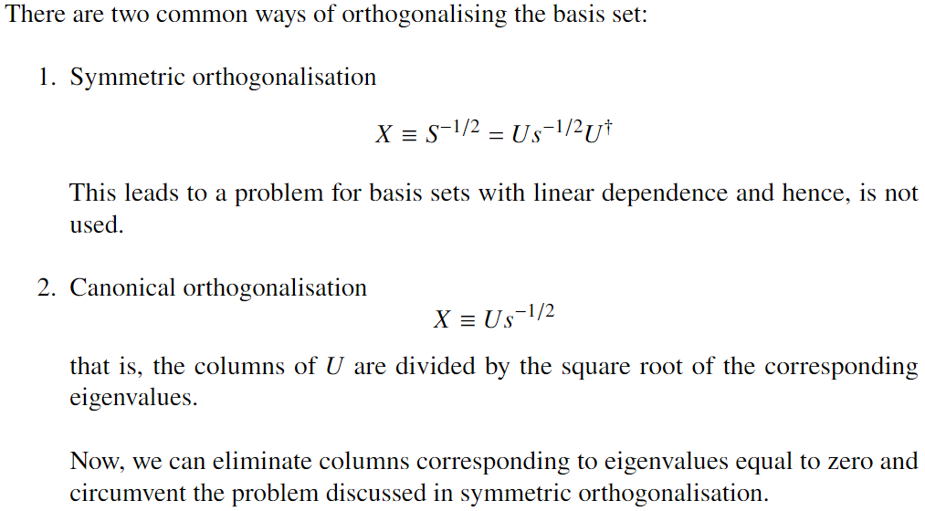
Orthogonalisation of basis: Solving the Roothan Eqs.

Slide 22
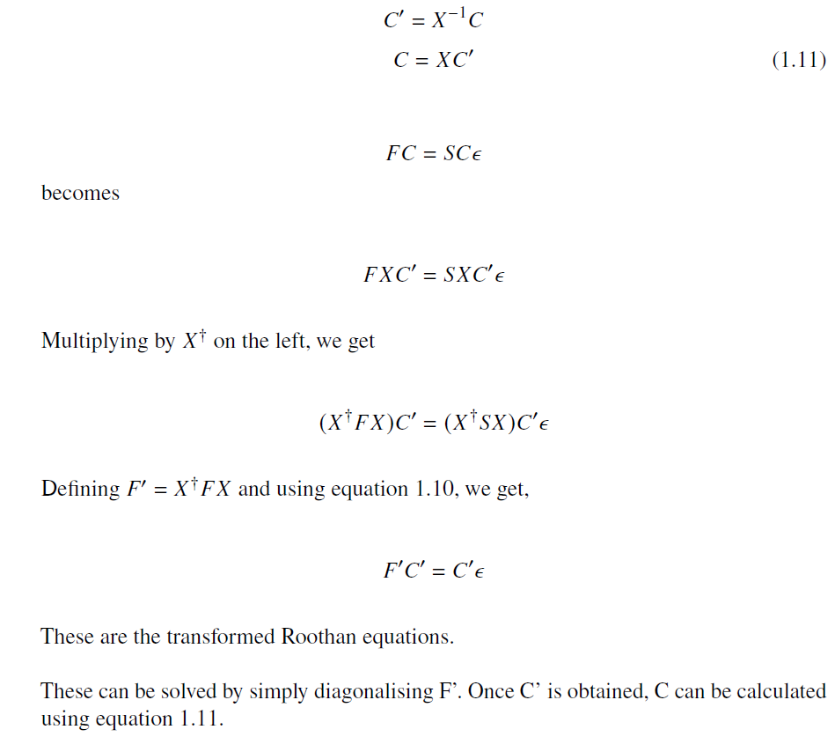
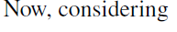
Orthogonalisation of basis: Solving the Roothan Eqs.

Slide 23
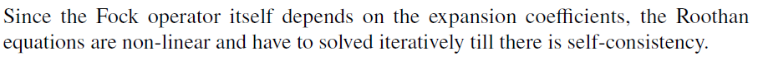
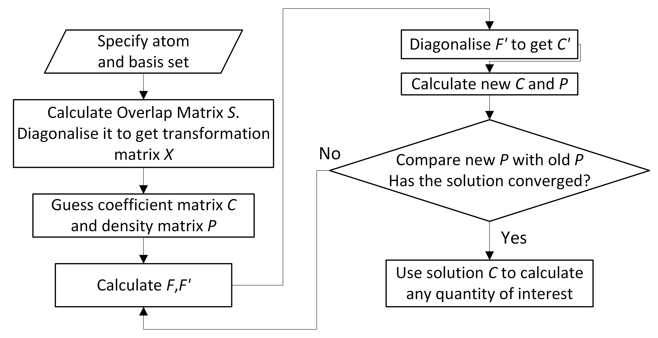
SCF Procedure

Slide 24
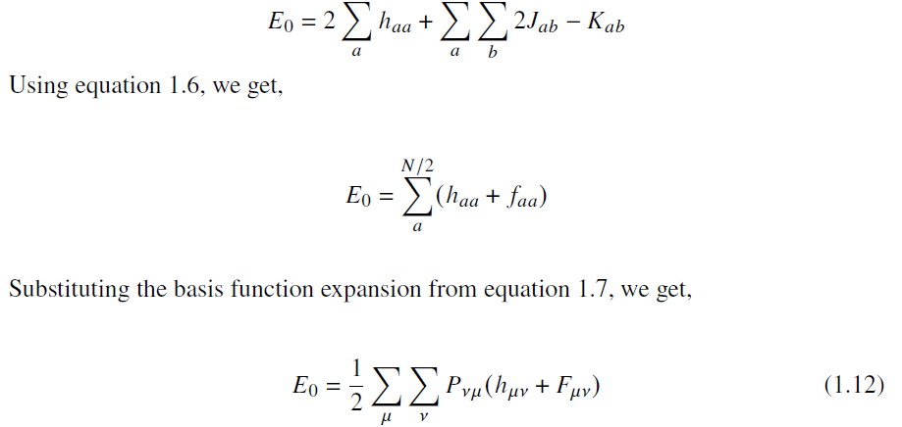
Total Energy

Slide 25
Gaussian Basis Set Expressions

Slide 26
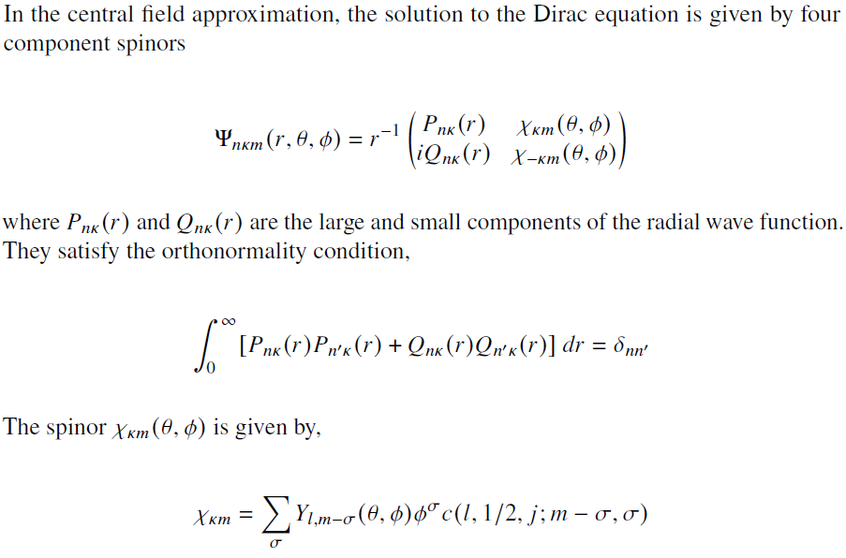
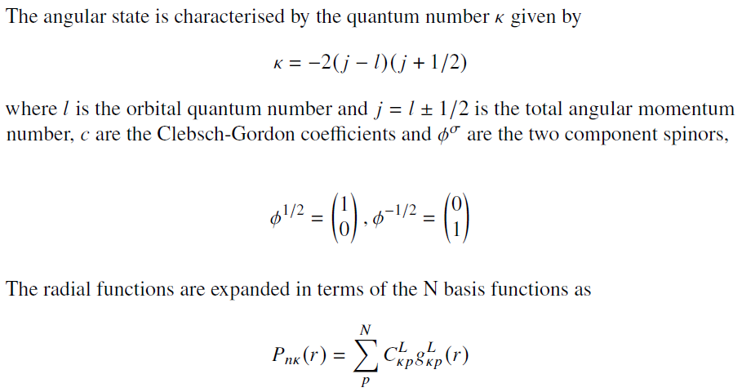
Basis

Slide 27
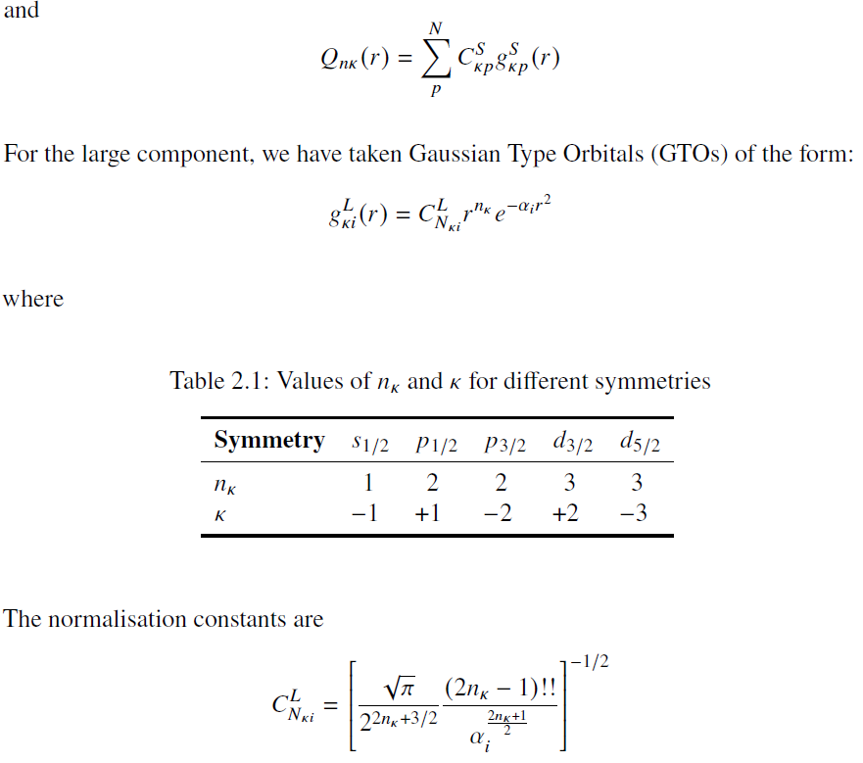
Basis

Slide 28
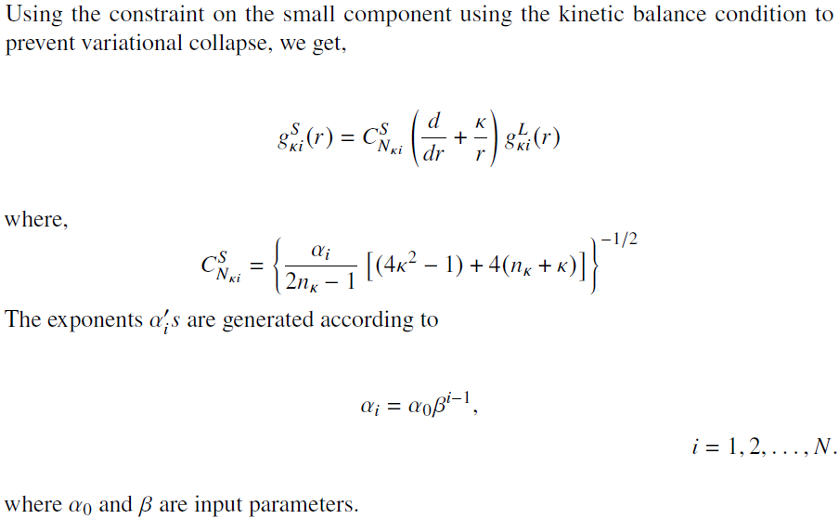
Basis

Slide 29
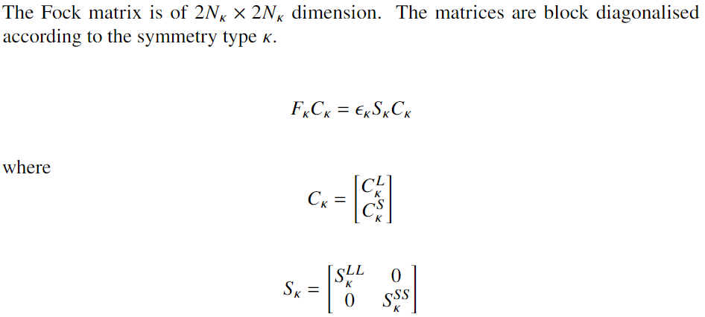
Relativistic Roothan Equations

Slide 30
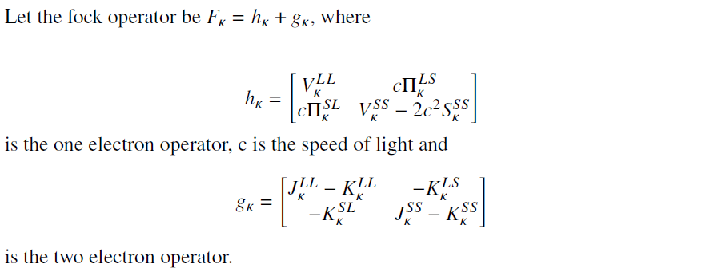
Relativistic Roothan Equations

Slide 31
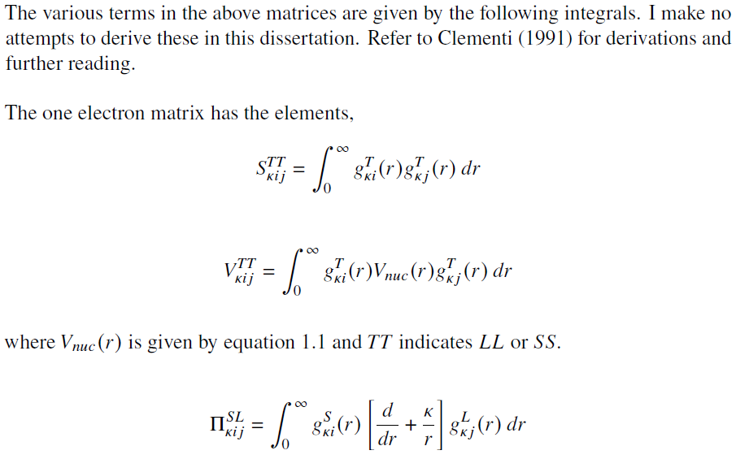
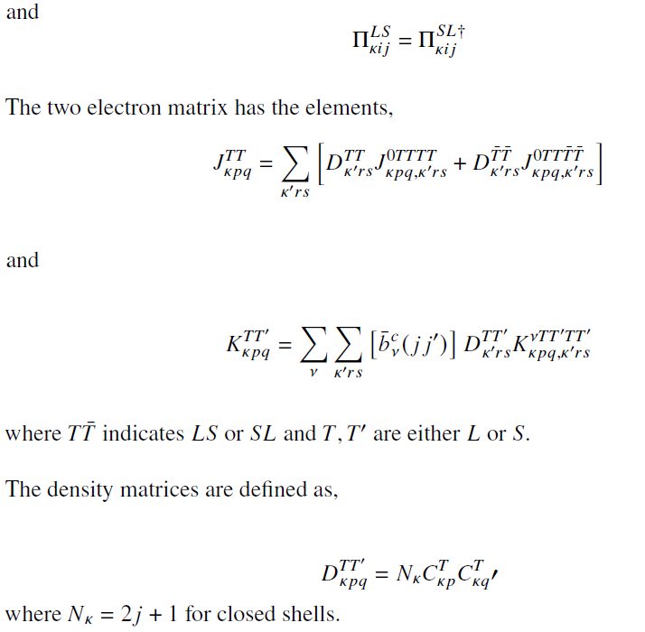
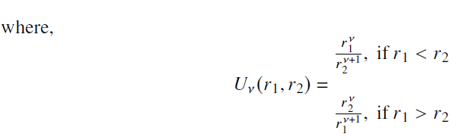
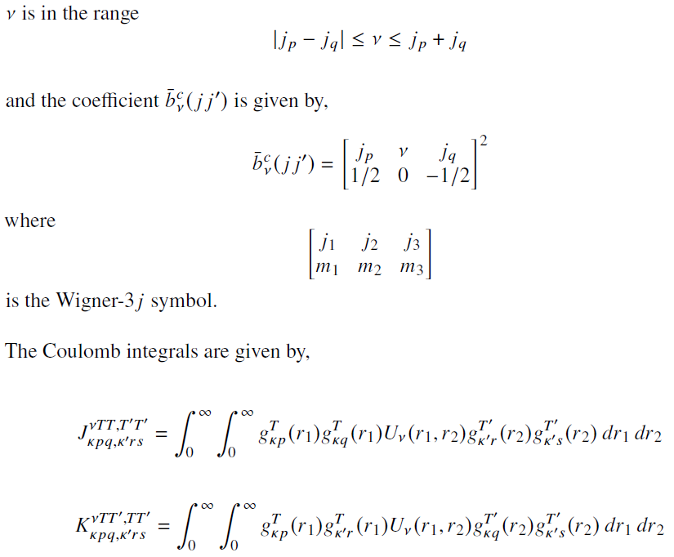
Relativistic Roothan Equations

Slide 32
Relativistic Roothan Equations

Slide 33
Relativistic Roothan Equations

Slide 34
Relativistic Roothan Equations

Slide 35
Code - Considerations

Slide 36
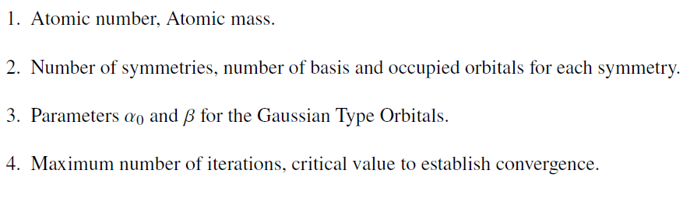
Input parameters

Slide 37
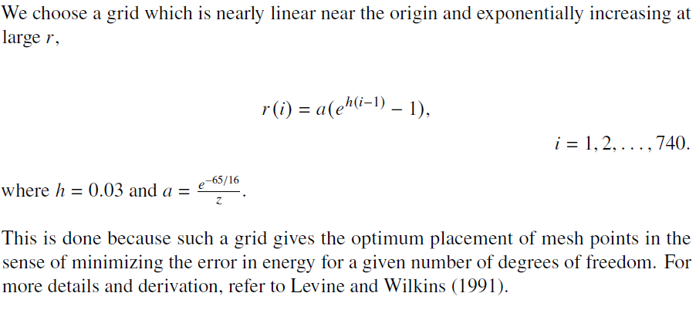
Grid

Slide 38
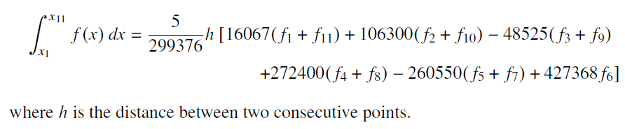
Integration and the Wigner-3j symbol

Slide 39
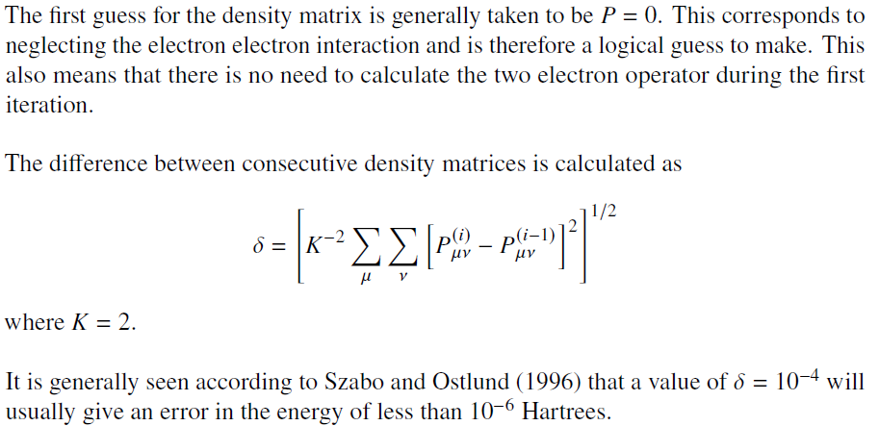
SCF Procedure

Slide 40
Failure and Suggestions

Slide 41
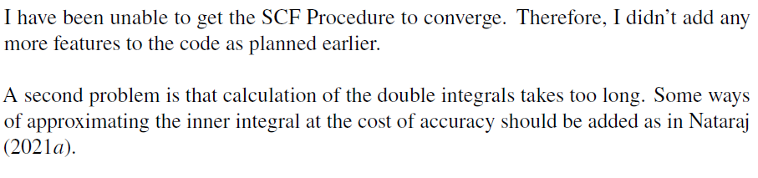
Failures

Slide 42
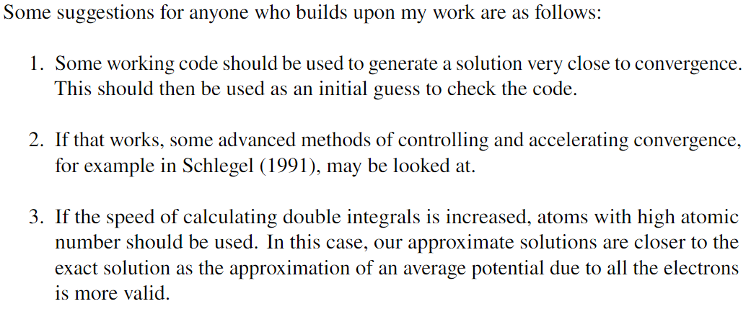
Suggestions

Slide 43
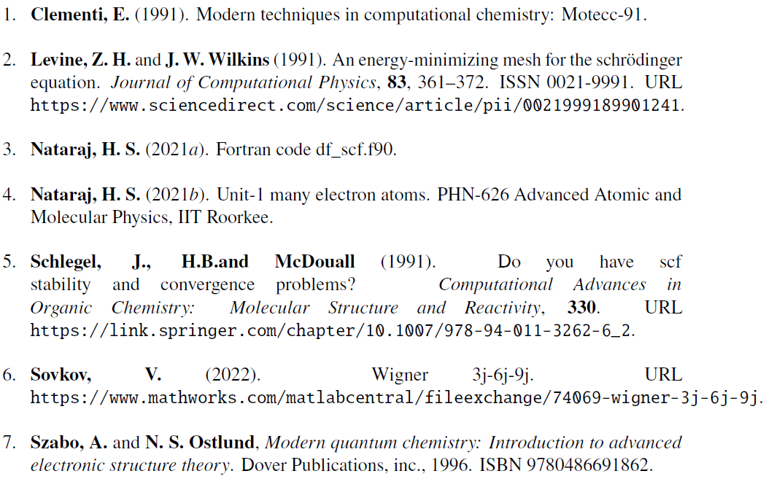
References

